Slide 1
Individual Progress Monitoring as a Data-Based Decision Making Tool
Alex Freeman
February 12, 2016
This presentation was financially supported in part by the Massachusetts School Psychologists Association as well as the Boston Teachers Union.

Slide 2
Outline
Comprehensive Behavioral Health Model (CBHM)
Behavior Intervention Monitoring Assessment System (BIMAS)
Behavioral Progress Monitoring
BIMAS Individual Progress Monitoring*
Case Studies*
Success, Challenges, Reflection*

Slide 4
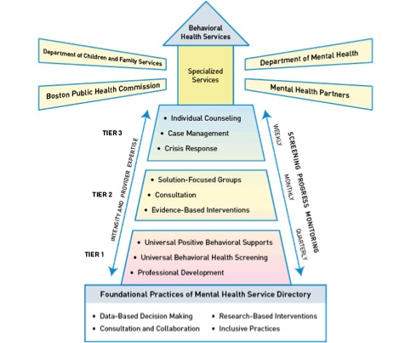

Slide 5
BIMAS: Overview
Measure of social, emotional and behavioral functioning in children and adolescents ages 5 to 18 years old.
“Universal Assessment” includes 34 change-sensitive items that are used for universal screening and for assessing response to intervention.
In BPS CBHM schools, students are screened by a teacher or staff person who knows them twice a year.

Slide 6
BIMAS: Scales
The BIMAS consists of:
three Behavioral Concern scales (Conduct, Negative Affect, and Cognitive/Attention)
two Adaptive scales (Social and Academic Functioning).
The Behavioral Concern Scale ratings are described as:
Low Risk, Some Risk, or High Risk.
The Adaptive scales ratings are described as:
Strength, Typical, or Concern.

Slide 7
BIMAS: Behavioral Concern Scales

Slide 8
BIMAS: Behavioral Concern Scales

Slide 9
BIMAS: Adaptive Scales

Slide 10
BIMAS: Adaptive Scales

Slide 11
BIMAS: Universal Assessment

Slide 12
BIMAS: Uses
Screening
Student Progress Monitoring
Program Evaluation
Notes:
Program Evaluation: to gather evidence that intervention services are effective.
Screening: as a brief screening device to detect students in need of further assessment and to identify their respective areas of strengths and needs.
Progress Monitoring: to provide feedback about the progress of individual students or clients.

Slide 13
Progress Monitoring: Research and Legislation
Data-based decision making and accountability is a “practice that permeates all aspects of service delivery” according to NASP’s Model of Comprehensive and Integrated School Psychological Services (2009). Progress monitoring is an essential component of these data-based decisions.
Federal and state legislation has encouraged the use of formative measures as a means to track academic progress over time. As such, many such measures are routinely used such as the Computerized Oral Reading Evaluation (CORE) measure of oral reading and the DIBELS measure of math fluency.

Slide 14
Progress Monitoring: Research and Legislation
Yet, while this legislation broadly calls for the use of both formative and summative measures in all areas, schools generally struggle to incorporate formative assessment related to behavioral concerns.
Such struggles are supported by research suggested there is yet to be developed a progress monitoring tool for social behavior that serves as a parallel to academic formative assessments (Gresham et. al. 2010).

Slide 15
Progress Monitoring: Best Practices
Progress monitoring is more valid, reliable and precise as the number of data points increase (Christ et. al. 2013).
Graphing of student-level data including rate of progress and trend lines is proven to be key in evaluating student response to intervention (McDougal, LeBlanc, Hintze 2010).

Slide 16
Progress Monitoring: Sample IEP Goals
…decrease off-task and self-stimulatory behaviors, increase expressive language skills, and develop adaptive age appropriate socialization skills 90% of the time.
…develop responsible behavior skills 80% of the time.
…identify and manage feelings (i.e., anger, anxiety, stress, frustration) on a daily basis.
…work productively in class with his peers despite being upset or having personal concerns.
…initiate social interaction with a peer 80% of programmed opportunities.
…given a problem situation, will engage in self-advocacy across 2 person and 2 settings with 90% of opportunities across 3 consecutive weeks.
Notes:
Yet, how often are these effectively monitored and accurately reported at IEP meetings? Consider the implications for goals connected to School Psychology direct counseling service (generalization of skills) as well as teachers’ capacity.

Slide 17
Progress Monitoring: Context – Haley Piilot

Slide 18
Progress Monitoring: Context – Haley Pilot
Special Populations
Special Education | English Language Learner | Low Income
22.4% | 14.5% | 51.0%

Slide 19
Progress Monitoring: Self-Regulation and School Readiness Goals
IEP Goal Analysis
Disability category | Total IEPs | Number students with Self-Regulation or School Readiness goals | Percentage of disability category with Self-Regulation or School Readiness goals
Autism | 32 | 27 | 84%
Communication | 23 | 4 | 17%
Developmental Delay | 30 | 17 | 6%
Emotional | 7 | 7 | 100%
Health | 5 | 2 | 40%
Intellectual | 3 | 2 | 67%
Specific Learning Disability | 22 | 7 | 32%

Slide 20
Progress Monitoring: Universal Assessment (Self-Regulation and School Readiness)
 | Behavioral Concern Scales |  |  |  |  |  | Adaptive Scales
Scale | Conduct |  | Negative Affect |  | Cognitive-Attention |  | Social | Academic Function.
Risk Level | High | Some | High | Some | High | Some | Concern | Concern
2013 – 2014 Assessment 1 | 7% | 21% | 11% | 22% | 12% | 18% | 22% | 22%
2013 – 2014 Assessment 2 | 8% | 17% | 13% | 19% | 14% | 15% | 21% | 16%
2014 – 2015 Assessment 1 | 9% | 16% | 8% | 19% | 14% | 20% | 28% | 22%

Slide 21
Progress Monitoring: Year 1
Starting in November 2014, each Friday teachers received weekly emails for BIMAS Progress Monitoring for all students with IEP Self-Regulation and School Readiness goals.
Emails contained a link to a website with one to six questions asking the frequency (very often, often, sometimes, rarely, never) of positively stated behaviors (i.e., “stayed on task”) observed within the last week.
Completing Progress Monitoring typically took 30 seconds, as answering the questions simply requires one to select a button on the computer screen and hit “save.”
Notes:
The Flex Items (positively stated behaviors) were directly linked to wordage from the IEPs, and could, thus, be used as relevant data regarding progress toward IEP goals at annual /reevaluation IEP meetings.

Slide 22
Progress Monitoring Participation
2014 – 2015
Total Population | SPED Population | Progress Monitoring (entered) | Progress Monitoring (regularly completed)
390 | 167 | 66 | 42
39% of Special Education students had Self-Regulation or School Readiness IEP goals; all of these students had individual Progress Monitoring set up in BIMAS. 63% of these students’ (those with individual Progress Monitoring set up in BIMAS) teachers regularly completed the weekly progress monitoring. 10% of the entire student population received individual Progress Monitoring.
Notes:
63 % is great - our universal screening only neared 70% THIS year, our fourth year of screening total.
So 63% for progress monitoring the first year you set it up is a success. :)

Slide 23
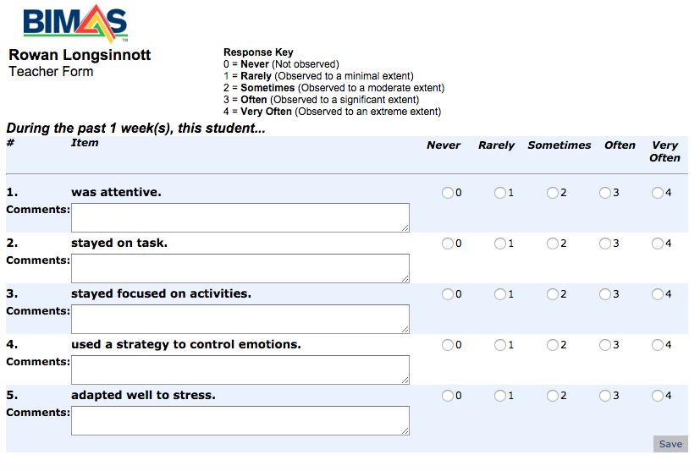

Slide 24
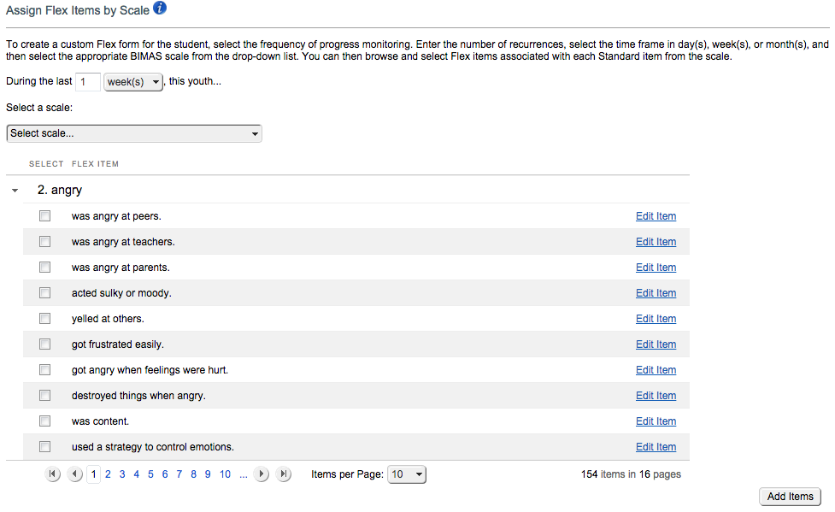

Slide 25
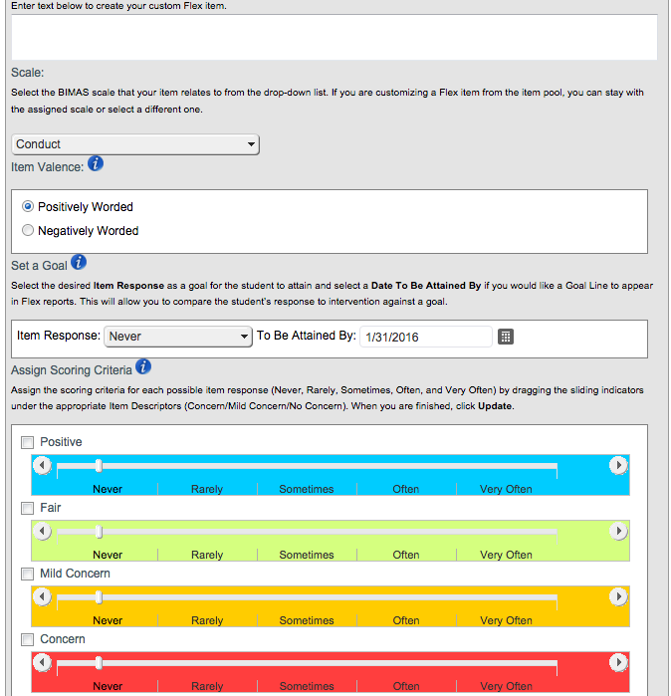

Slide 27
Individual Progress Monitoring Case Study 1
4th grader
Emotional Impairment
Counseling

Slide 28
Individual Progress Monitoring Case Study 1: IEP Goal
When [student name] becomes upset, frustrated or angry, [student name] will use a self regulation/coping strategy (movement break, deep breathing, positive self statements, preferred activity, etc.) to avoid engaging in unexpected behavior, with one reminder, in 4 out of 5 opportunities, as measured by observations and documentation.
Benchmark/Objectives: What will the student need to do to complete this goal?
In counseling sessions, [student name] will accurately identify feelings and appropriate coping strategies when presented with real or imagine situations with 80% accuracy in 4 out of 5 trials.
Given strategies in counseling sessions, [student name] will apply these strategies within the classroom environment in 4 out of 5 opportunities.

Slide 29
Individual Progress Monitoring Case Study 1
11/14 = 78%
moderately
effective

Slide 30
Percentage of Non-Overlapping Data (PND)
The number of post-intervention data points that exceed the highest baseline data point is divided by the total number of post-intervention points.
Directions:
Identify the highest baseline point.
Count the number of intervention points that exceed the highest baseline point (non-overlapping).
Calculate the proportion of non-overlapping to total number of intervention points (can’t use if baseline has a zero point).
Ratings:
90%+ → Highly Effective
70%-90% → Moderately Effective
50%-70% → Minimally Effective
>50% → Ineffective

Slide 31
Percentage of Non-Overlapping Data (PND) Limitations
Ceiling effects
Lacks sensitivity or discrimination ability as it nears 100% for very successful interventions
Can not detect slope changes
Needs its own interpretation guidelines
Technically not an effect size

Slide 32
Individual Progress Monitoring Case Study 1: IEP Goal
During instruction time and independent work time, [student name] will attend to the lesson and complete required work independently consistently.
Benchmark/Objectives: What will the student need to do to complete this goal?
By the first progress report of this IEP [student name] will sit and listen to a whole group lesson with fewer than 2 verbal prompts 4 out of 5 times.
By the second progress report of this IEP, [student name] will independently complete work that he is interested and engaged in 4 out of 5 times correctly.
By the third progress report of this IEP, [student name] will attempt unfamiliar or challenging work in a small group accompanied by a teacher 4 out of 5 times correctly.
By the end of this IEP, [student name] will independently complete unfamiliar and challenging work 4 out of 5 times correctly..

Slide 33
Individual Progress Monitoring Case Study 1
16/16 = 100%
highly effective

Slide 34
Individual Progress Monitoring Case Study 1
8/15 = 53%
minimally effective

Slide 35
Individual Progress Monitoring Case Study 1: Universal Assessment
 | Universal Assessment 1 (October) |  |  | Universal Assessment 2 (June)
 | T-Score | Percentile | Description | T-Score | Percentile | Description
Behavioral Concern Scales
Conduct | 76 | 99th | High Risk | 80 | 99th | High Risk
Negative Affect | 70 | 98th | High Risk | 79 | 99th | High Risk
Cognitive/Attention | 69 | 97th | Some Risk | 76 | 99th | High Risk
Adaptive Skills Scales
Social | 36 | 8th | Concern | 23 | 1st | Concern
Academic Functioning | 33 | 4th | Concern | 21 | 1st | Concern

Slide 36
Case Study 2
2nd grader
Health Impairment
Not receiving School Psychologist counseling

Slide 37
Individual Progress Monitoring Case Study 2: IEP Goal
Given a checklist and minimal cuing, [student name] will initiate and complete a given task on a regular basis.
Benchmark/Objectives: What will the student need to do to complete this goal?
Given teacher instructions, minimal prompts and with the aid of a checklist, [student name] will focus on a task and complete it 75% of the time.

Slide 38
Individual Progress Monitoring Case Study 2
8/15 = 53%
minimally effective

Slide 39
Individual Progress Monitoring Case Study 2
12/15 = 80%
moderately effective

Slide 40
Individual Progress Monitoring Case Study 2: Universal Assessment
 | Universal Assessment 1 (October) |  |  | Universal Assessment 2 (June)
 | T-Score | Percentile | Description | T-Score | Percentile | Description
Behavioral Concern Scales
Conduct | 65 | 93rd | Some Risk | 56 | 74th | Low Risk
Negative Affect | 61 | 87th | Some Risk | 50 | 50th | Low Risk
Cognitive/Attention | 73 | 99th | High Risk | 63 | 90th | Some Risk
Adaptive Skills Scales
Social | 25 | 1st | Concern | 29 | 2nd | Concern
Academic Functioning | 28 | 2nd | Concern | 30 | 2nd | Concern

Slide 41
Universal Assessment: Assessment 1 and 2
 | Behavioral Concern Scales |  |  |  |  |  | Adaptive Scales
Scale | Conduct |  | Negative Affect |  | Cognitive-Attention |  | Social | Academic Function.
Risk Level | High | Some | High | Some | High | Some | Concern | Concern
2014 – 2015 Assessment 1 | 9% | 16% | 8% | 19% | 14% | 20% | 28% | 22%
2014 – 2015 Assessment 2 | 10% | 18% | 12% | 22% | 14% | 23% | 30% | 27%

Slide 43
Successes
IEP meetings
Behavior Plans
Counseling → ability to write relevant, data-based IEP goals
Student Support Team meetings
Department

Slide 44
Challenges
Foremost:
time consuming
Downloading all IEPs and combing through each one for Self-Regulation and School Readiness goals.
Sending individual emails to teachers each week.
Finding corresponding Flex Items within BIMAS to link to goals and setting up Flex Items for each student within the BIMAS system.
Running and printing reports in preparation for meetings.

Slide 45
Challenges
Not all teachers were willing to complete, and there was no mandate they do so. Each week ~75% of the classrooms participated.
Flex Items were based on IEP goals set at the beginning of the year; no system to update goals as annual and re-evaluation meetings occurred.
Flex Items were only as useful as the IEP goals themselves.

Slide 46
Reflection
Capacity: (1) teachers set up Progress Monitoring and run Flex Individual Progress Reports independently and (2) teachers share the Flex Individual Progress Reports.
Flex Items: (1) utility of Flex Items versus directly copying IEP goals and (2) utility of positively stated behaviors when IEP goals frequently spoke to problem behaviors.
Timing: System for updating Flex Items/Progress Monitoring as IEP goals change.

Slide 47
Individual Progress Monitoring Year 2

Slide 48
Questions?
Alex Freeman
afreeman5@bostonpublicschools.org

